Slide 1



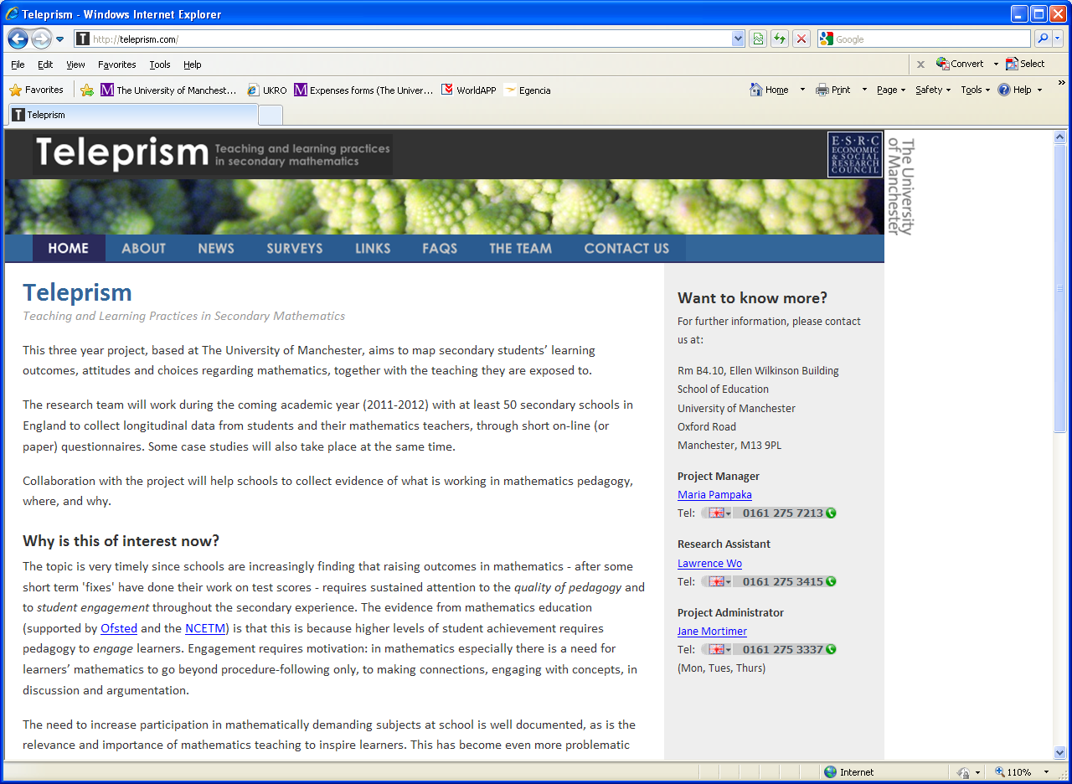
Teaching and Learning Practices in Secondary Mathematics: measuring teaching from teachers’ and students’ perspective
Maria Pampaka, Lawrence Wo, Afroditi Kalambouka, Sophina Qasim & David Swanson
6th September 2012
BERA, Manchester

Slide 2
The project: TeLePriSM
“Mathematics teaching and learning in secondary schools: the impact of pedagogical practices on important learning outcomes” (ESRC: RES-061-25-0538)
(2011-2014)
Teaching and Learning Practices in Secondary Mathematics

Slide 3
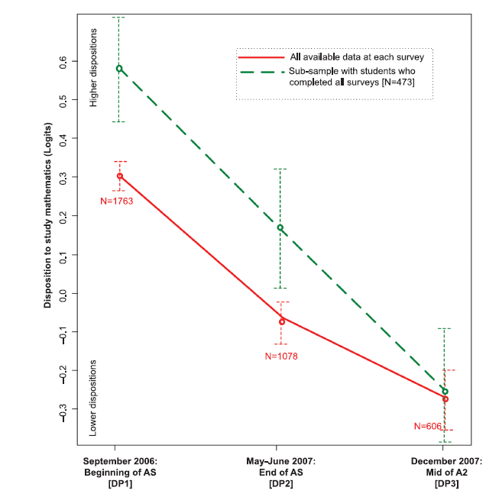
Motivation …Previous results
The STEM issue
STEM: Science Technology, Engineering and Mathematics
Participation remains problematic
Students dispositions are declining

Slide 4
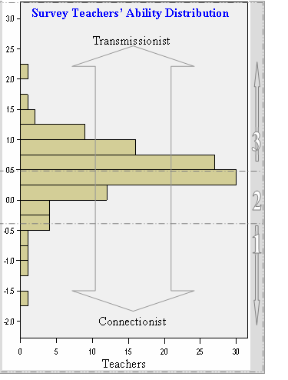
Negative effect of transmissionist pedagogy at AS and A Level on students maths dispositions

Slide 5
Common Trends from UK and Norway (TransMaths)
➔ Transmissionist teaching at school (pre-uni) is associated with lower confidence and maths dispositions
➔ Smaller effect as students progress in HE – but still significant dispositions

Slide 6
Outline
Project overall description & aims
Methods
Analysis –some results
Emerging conclusions

Slide 7
TeLePriSM
Aim: To map secondary students’ learning outcomes and choices, including dispositions and attitudes, together with the teaching they are exposed to.
Surveys for students from Years 7 to 11 (3 times) and also for their mathematics teacher (twice).
Case studies in a small number of schools with lesson observations and interviews with students and teachers.

Slide 8
Particular Aims
to understand how learners’ dispositions to study Mathematics develop through Secondary School (i.e. KS3 and KS4)
to understand how mathematics pedagogies vary across different situations and contexts,
to understand how different pedagogies, programmes and school contexts influence learning outcomes, including dispositions, and
to solve a series of measurement and analytical challenges involving a synthesis of longitudinal and cross-sectional analyses, and dealing with missing data.

Slide 9
Aims Today
How are we measuring teaching practices in secondary mathematics?
From students’ and teachers’ point of view
Agreement between the two?
Differences between Year Groups?
How are these ‘measures’ of pedagogy associated with other variables (students’ dispositions)

Slide 10
The Teleprism survey design

Slide 11
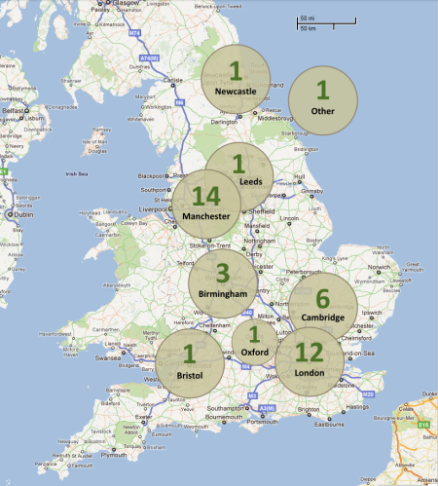
Participating schools
Students

Slide 12
Analytical/Methodological Framework

Slide 13
The Student Survey Development
Different Sections:
Background Information
Attitudes/Dispositions to Maths
Aspirations/Future Choices
Perception of Maths Teaching
Maths Self-efficacy (confidence)
Build on previous (TransMaths) surveys and broader relevant literature

Slide 14
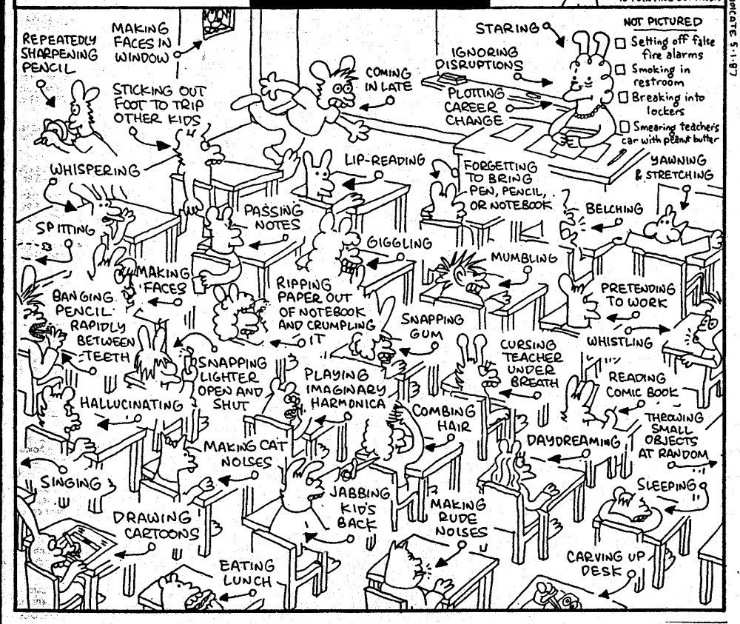
Capturing what’s happening during maths lessons

Slide 15
How is maths taught this year?
26 items

Slide 16
The teacher instrument
30 items

Slide 17
Measures Validation

Slide 18
Measurement Methodology
‘Theoretically’: Rasch Analysis
Partial Credit Model
Rating Scale Model
‘In practice’ – the tools:
FACETS, Quest and Winsteps software
Interpreting Results:
Fit Statistics (to ensure unidimensional measures)
Differential Item Functioning for ‘subject’ groups
Person-Item maps for hierarchy

Slide 19
Before the Rasch Model

Slide 20
After: The Rasch Item-Map Hierarchy…

Slide 21
During the process… Item fit statistics

Slide 22
Differential Item Functioning across Year Groups
22: We use calculators
16: We do projects that include other school subjects
21: We get assignments to research topics on our own
Notes:
As shown, items 21 and 22 first, and then item 16 exhibit differences all at the same direction. Doing projects/assignments on their own (item 21) or involving other school subjects (item 16) occur in much less frequency as students move from Year 7 to Year 11 (those items were reversely coded). On the contrary, and probably as expected, the use of calculators is more frequent in Years 10 and 11.

Slide 23
Some evidence for differences in interview data:
Student: In younger years, like Year 8 and 9, maybe Year 7 I can’t really remember, we used to go in the computer room there but we used to do maths on the computer, but then not anymore.

Slide 24
The Rasch Item-Map Hierarchy…

Slide 25
Agreement between teachers and students scores (?)
Matched dataset at class-teacher level
Data from 128 teachers ➔264 classrooms
Average student score (compromise!)
Correlation 0.2 (but stat significant)
Still to explore with multi-level analysis

Slide 26
Further analysis
Descriptive

Slide 27
The picture…

Slide 28
Student-level data: By Year Group

Slide 29
Year Group – Gender

Slide 30
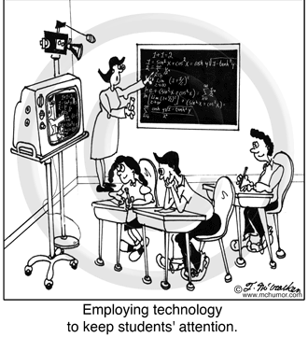
Are some practices more engaging?
In other words:
association of the measure of pedagogy perception with variables relevant to students’ mathematics dispositions

Slide 31


Students’ favourite and least favourite topics

Slide 32
Pedagogy by ‘preference’

Slide 33
Limitations and further work
Tentative preliminary analysis
Validation should be complemented with qualitative data from interviews with students and teachers (see Qasim et. Al, BERA 2012)
Some of the resulting associations may be masked by interactions with other variables (further tested with generalised linear models)
Multilevel modelling will also be pursuit to deal with the hierarchical structure of the data

Slide 34
Concluding Points – From press release
Twenty-first century maths lessons in English secondary schools are generally much like those of decades ago, with the teacher standing at the front of the class asking questions and opportunities for pupils to relate the subject to their real lives relatively sparse.
And the GCSE exams system seems to underscore this position, with lessons becoming increasingly routine and less interactive as pupils get older and approach the end of their compulsory schooling careers.
This may be a factor in maths ranking as the subject secondary pupils are most likely to say they dislike, although it also has among the highest number of pupils naming it as their preferred choice.

Slide 35
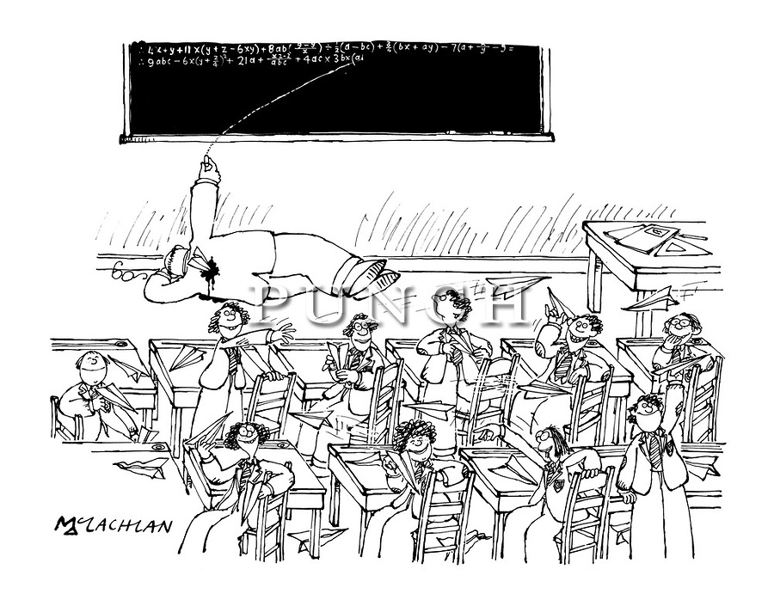
Is there a common ground for teaching for good results (exams) and engaging students in maths?
Thank you!
www.teleprism.com

